Slide 1

PER FLOOR JUMP ADD 10K CONSERVATIVELY.
SOME LEVELS MAY JUMP MORE FOR UNBLOCK VIEW
STARTING FROM PRICES FROM LESS FAVOURABLE FACINGS
BE PREPARED +50K TO 80K FOR CHOICE FACINGS
$2.378MIL 2375PSF
$2.838MIL 2463PSF

Slide 2
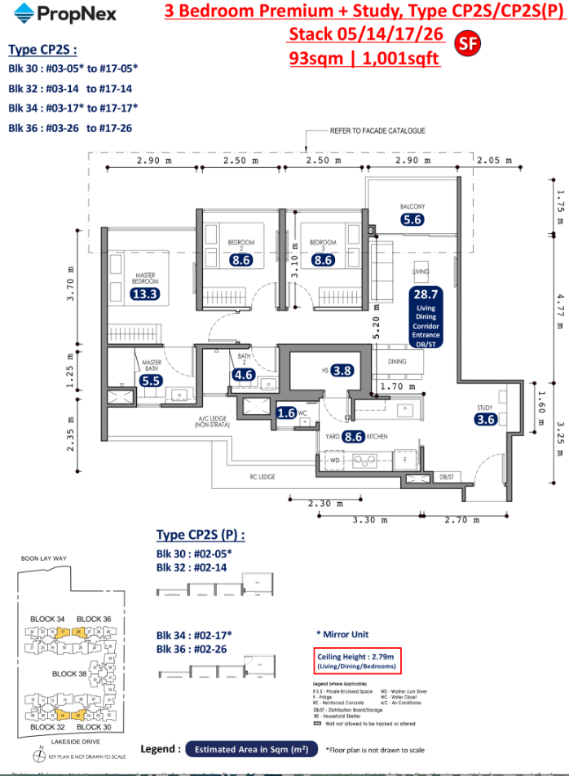
#03 $2.328mil 2326psf
#04 $2.338mil 2335psf
#05 $2.348mil 2345psf
#06 $2.358mil 2355psf
#07 $2.368mil 2365psf
ADD 10K FOR FACING
#03 $2.338mil 2335psf
#04 $2.348mil 2345psf
CLEAR SCHOOL MAY JUMP
20K TO 50K (AVERAGE 25K)
#05 $2.373mil 2370psf
#06 $2.383mil 2380psf
#07 #2.393mil 2390psf
#08 $2.403mil 2400psf
#09 $2.413mil 2410psf
#10 $2.423mil 2420psf
#11 $2.433mil 2430psf
Notes:
I DO CONSERVATIVE ADD 10K FOR FACING ONLY. DEVELOPER MAY WHACK 50K FOR FACING

Slide 3
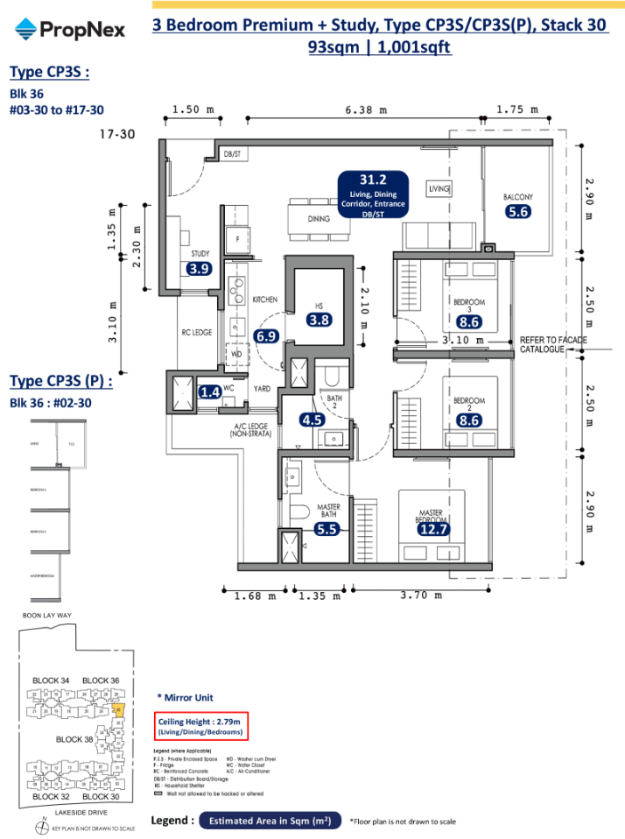
#03 $2.328mil 2326psf
#04 $2.338mil 2335psf
#05 $2.348mil 2345psf
#06 $2.358mil 2355psf
#07 $2.368mil 2365psf
ADD 10K FOR FACING
although see lake, its residential plot in future
#03 $2.338mil 2335psf
#04 $2.348mil 2345psf
CLEAR MRT MAY JUMP
20K TO 50K (AVERAGE 25K)
#05 $2.373mil 2370psf
#06 $2.383mil 2380psf
#07 #2.393mil 2390psf
#08 $2.403mil 2400psf
#09 $2.413mil 2410psf
#10 $2.423mil 2420psf
#11 $2.433mil 2430psf
Notes:
I DO CONSERVATIVE ADD 10K FOR FACING ONLY. DEVELOPER MAY WHACK 50K FOR FACING

Slide 4
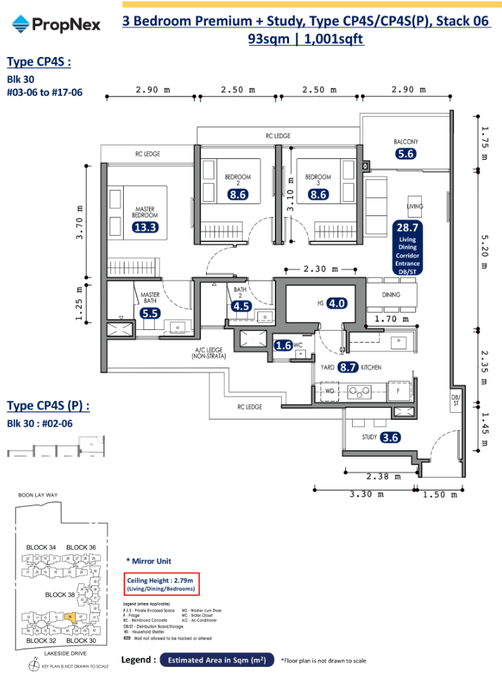
ADD 15K FOR POOL
#03 $2.343mil 2340psf
#04 $2.353mil 2350psf
CERTAIN FLOOR MAY JUMP
20K TO 50K (use 20k)
#05 $2.373mil 2370psf
#06 $2.383mil 2380psf
#07 #2.393mil 2390psf
#08 $2.403mil 2400psf
#09 $2.413mil 2410psf
#10 $2.423mil 2420psf
#11 $2.433mil 2430psf
Notes:
I DO CONSERVATIVE ADD 15K FOR FACING ONLY. DEVELOPER MAY WHACK 50K FOR FACING

Slide 5
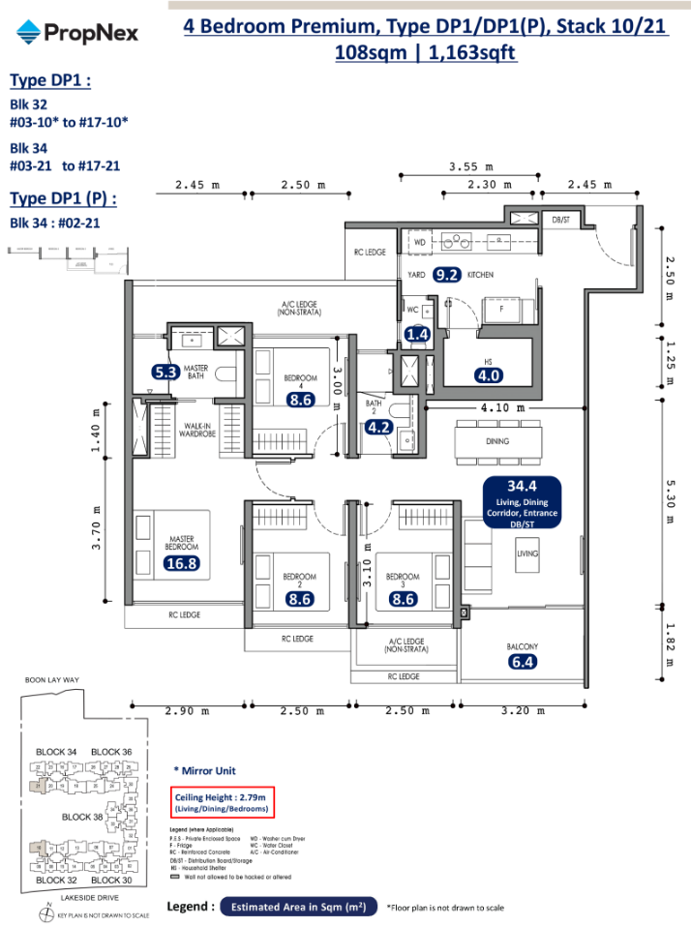
NON SUN STACK
MAYBE 5K TO 10K MORE (USE 5K)
#03 $2.793mil 2420psf
#04 $2.803mil 2405psf
AFTER #04 MAY JUMP
20K TO 50K (put 20K)
#05 $2.823mil 2427psf
#06 $2.833mil 2435psf
#07 #2.843mil 2444psf
#08 $2.853mil 2453psf
#09 $2.863mil 2461psf
#10 $2.873mil 2470psf
#11 $2.883mil 2478psf
WEST SUN STACK
#03 $2.788mil 2420psf
#04 $2.798mil 2405psf
AFTER #04 MAY JUMP
20K TO 50K (put 20K)
#05 $2.818.mil 2423psf
#06 $2.828mil 2431psf
#07 #2.838mil 2440psf
#08 $2.848mil 2448psf
#09 $2.858mil 2457psf
#10 $2.868mil 2466psf
#11 $2.878mil 2474psf
Notes:
I DO CONSERVATIVE ADD 10K FOR FACING ONLY. DEVELOPER MAY WHACK 50K FOR FACING

Slide 6
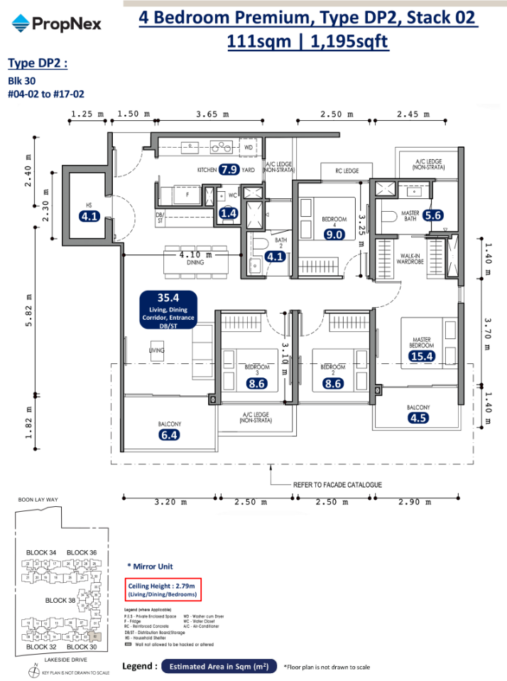
ADD 10K FOR SCHOOL FACING/ from left side can see lake so maybe more expensive than pool
#03 $2.803mil 2345psf
#04 $2813.mil 2353psf
CLEAR SCHOOL MAY JUMP
20K TO 50K (AVERAGE 25K)
#05 $2.838mil 2374psf
#06 $2.848mil 2383psf
#07 #2.858mil 2391psf
#08 $2.868mil 2400psf
#09 $2.878mil 2408psf
#10 $2.888mil 2416psf
#11 $2.898mil 2425psf
Notes:
I DO CONSERVATIVE ADD 10K FOR FACING ONLY. DEVELOPER MAY WHACK 50K FOR FACING

